Slide 1
ONE STOP SOLUTION FOCUSING ON TOURISM – TOUR VISTA
PIP104 PROFESSIONAL PRACTICE-II
VIVA-VOCE
Batch Number: 27
Roll Number 20211CAI0057 20221LCA0067 20211CAI0089 | Student Name : SUHAS K SMRUTI S NAIR SAHANA K H
Under the Supervision of,
Dr. Nihar Rajan Nayak,
Assistant Professor,
School of Computer Science Engineering,
Presidency University.

Slide 2
Introduction:
Tour Vista is the first of its kind AI-driven travel planning website that aims to smoothen and humanize the traveling experience for its users. This application employs generative AI through Google Gemini and is further based on Firebase for backend services to create itineraries that fulfill personal preferences, budgets, and group sizes. Such fine-tuning of technologies, thus, gives way for travelers to promote personal making of trip plans right across their entire journey. Using real-time images from Google brings an up-close view to users about their selected destinations, and dynamic, informative mapping adds depth and enjoyment to the travel experience with information on location-based features. This combination of views and navigation allows users to layout travel plans with confidence. Basically, Tour Vista is a way through which travel is discovered and planned. The website gives power to users to build remarkable travel experiences with generative AI, real-time data interaction, and intuitive design. It is a full-fledged travel partner-from exposing hidden gems to dreaming up an ideal vacation, turning trip planning into an engaging and intuitive experience.

Slide 3
Literature Review:
Real-Time Systems in Tourism Smith and Johnson highlighted the role of real-time systems in providing instant travel updates and managing resources during peak seasons, enhancing traveler satisfaction.
AI-Based Chatbots Brown et al. demonstrated how AI chatbots improve tourism platforms through personalized recommendations and instant responses, streamlining the travel experience.
User-Friendly Platforms Taylor and Wilson underscored the need for simple, intuitive platforms to ensure accessibility for users with varying technical skills.
Emergency Preparedness Miller and Carter discussed strategies for real-time data sharing and coordination to ensure traveler safety during crises.

Slide 4
Research Gaps Identified:
Integration and Interoperability:
Explore seamless integration of real-time updates, AI-driven recommendations, and diverse tourism data sources.
Security and Privacy:
Investigate robust security measures to protect user data, especially during transactions or when sharing personal travel details.
Usability and User Experience:
Enhance user interfaces and experiences to cater to diverse travelers, ensuring simplicity and accessibility.
Scalability and Performance:
Develop scalable architectures to handle increasing users and data, especially during peak travel seasons.

Slide 5
Proposed Methodology:
Centralized Database:
Manage hospital details (name, address, beds, specialties, etc.)
with real-time synchronization.
Search and Filters:
Enable hospital search by name, location, or specialty and
sort by proximity or ratings.
Emergency Indicators:
Highlight hospitals with active emergencies using visual
badges or icons.
4. Admin Dashboard:
Allow hospital admins to add, edit, or remove records,
update statuses, and validate data consistency.
5. Real-Time Updates:
Refresh data every 30 seconds using APIs for up-to-date information.

Slide 6
Objectives:
Personalized Trip Planning:
Tour Vista leverages Google’s Gemini AI to create tailored trip plans based on user inputs like budget, group size, and activity preferences, balancing cost-effective options and premium experiences.
Real-time Data Integration:
Using Google Places API, Tour Vista provides real-time data on accommodations, activities, and restaurants, ensuring users access accurate, up-to-date information for seamless planning.
Engaging User Interface:
The platform features an intuitive, interactive UI with drag-and-drop itinerary management and interactive maps, enhancing user engagement and exploration.
Backend:
Powered by Firebase, Tour Vista ensures secure user authentication, real-time updates via Firestore, and enhanced multimedia management through Cloud Storage, delivering a seamless and secure user experience.

Slide 7
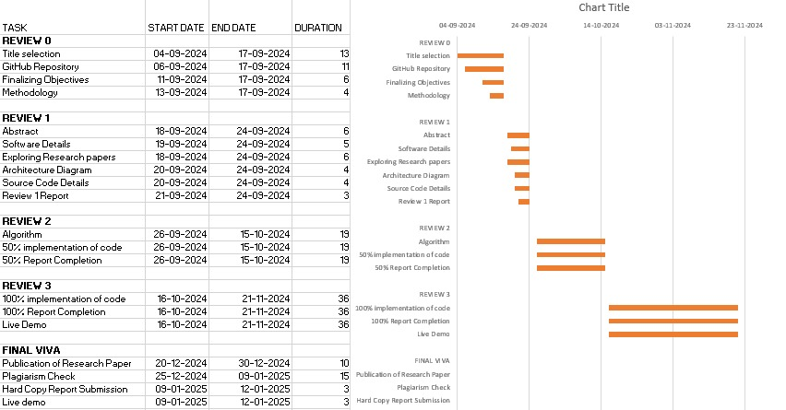
Timeline of Project:

Slide 8
Conclusion:
To cut a long story short, Tour Vista is a generational leap in travel planning using generative AI and harnessing the power of real-time data integration. By facilitating enjoyable travel to tailor-made itineraries for each individual user, making trip planning a seamless experience was partially realized. Tour Vista has changed the face of travel planning by turning it, at times intimidating, into users' excitement for travel by providing an easy-to-use interface and complete trip management options that took the burden off users.
Along with that, real-time information on destinations, accommodations, and activities will be provided by the Google Places API for travelers. The collaborative trip planning makes it more engaging for users, as they can include family and friends in the planning process and provide more shared experiences. Therefore, this project will continuously add the potential for future improvement by adding offline functionalities, integration of weather, functionalities to book, etc. These will add value and attraction to the app in turn. Above all, Tour Vista sets the new benchmark of the travel planning application, answering to the ever-changing needs of a traveler, and will help create connected and informed travelers into existence.

Slide 9
References:
Hamouda, M. (2022). Mobile applications in tourism: Examining the determinants of intention to use. International Journal of Technology and Human Interaction, 18(1), 1–13
Seker, F., Kadirhan, G., & Erdem, A. (2023). The factors affecting tourism mobile apps usage. Tourism & Management Studies, 19(1), 1–15.
Sutresno, S. A., & Singgalen, Y. A. (2023). Digital innovation design of tourism destination marketing website using design thinking method. Journal of Information Systems and Informatics, 5(2), 428–444.
Karunathilaka, H. M. C. H., Jayasinghe, J. A. M. P., Gunasekara, W. M. A. S., Fernando, W. T. R. P., De Silva, D. I., & Gunathilaka, M. P. (2023). TourVista: Tour guide web application. Tuijin Jishu/Journal of Propulsion Technology, 44(6), 335–336.
Maurya, H., Guthale, K. K., Kolekar, R. B., Shirke, S. M., & Jejurkar, A. H. (2023). Trip4u: Responsive tourism website for tour and travel management. International Journal of Advanced Research in Science, Communication and Technology, 3(2), 125–135.

Slide 10
GitHub Link:
ONE STOP SOLUTION FOCUSING ON TOURISM – TOUR VISTA

Slide 11

Thank You

